Slide 2
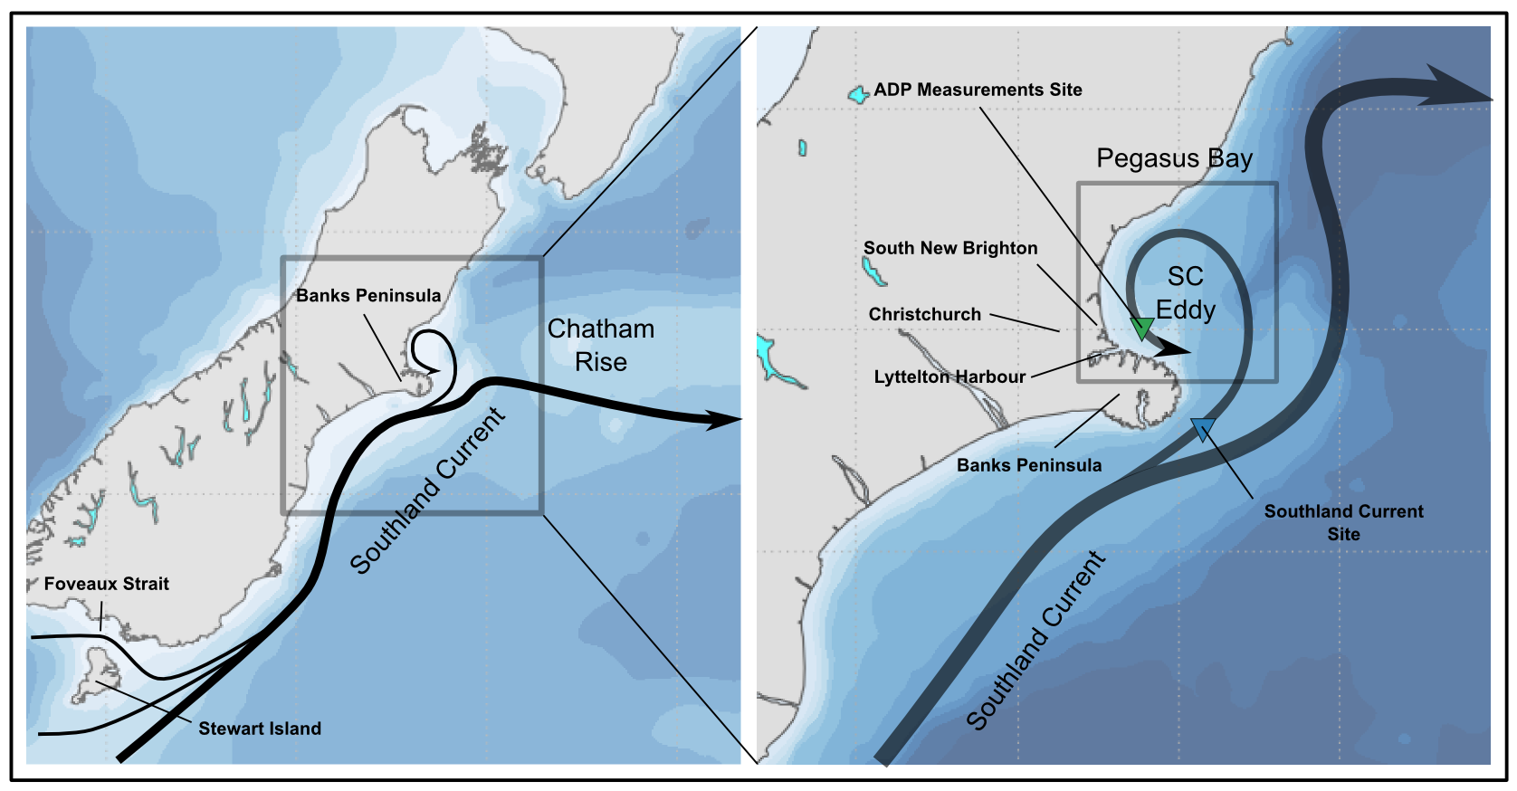
Motivation FIX THE RIGHT PANEL SC SEPARATION
According to Chiswell (1996) and Reynolds-Flemming et al. (2005)
www.metocean.co.nz

Slide 3
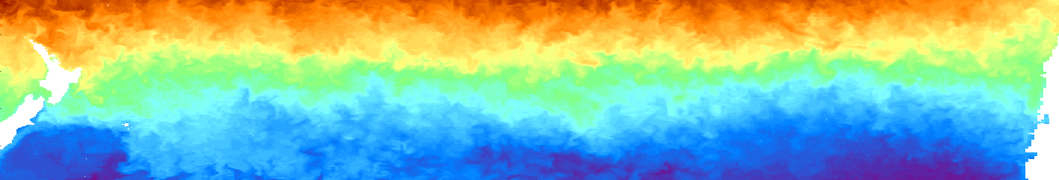
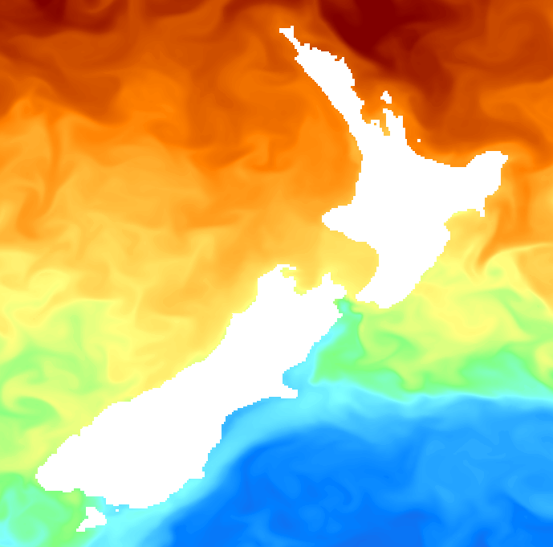
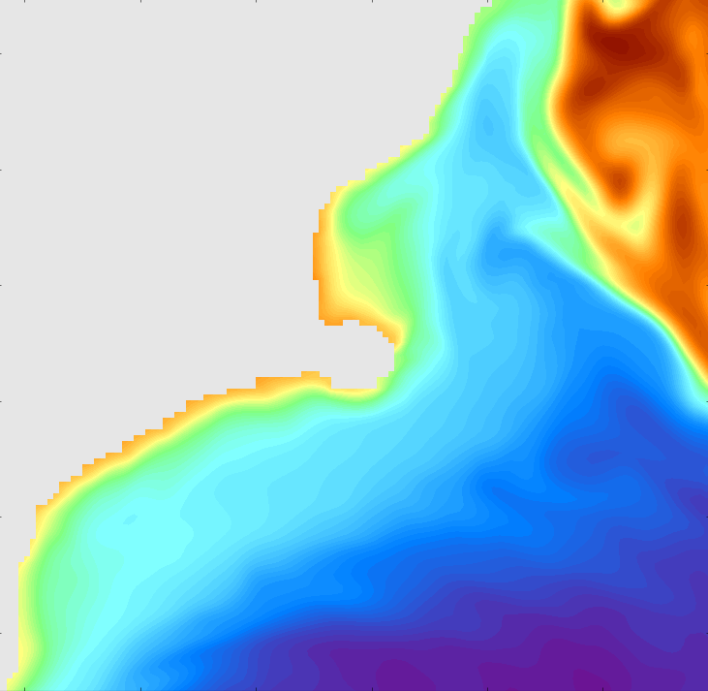
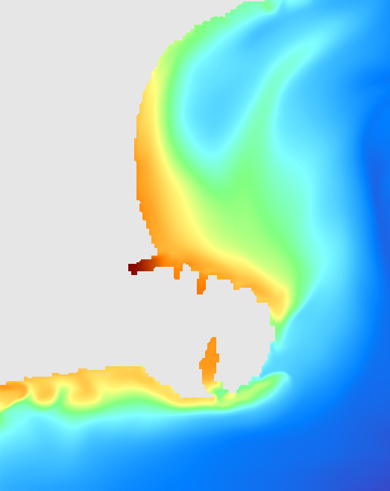
Overview of the forcing mechanisms
NZ
Rossby Waves: ~10-30 days, ~100-200 km
Chile
Eddies + topography +
Local BC instabilities
Southland current eddy
Winds
Coastal jets and waves
Frontal structures
Tides
Winds
100 km
100 km
Rossby Waves
Southland Current
www.metocean.co.nz

Slide 4
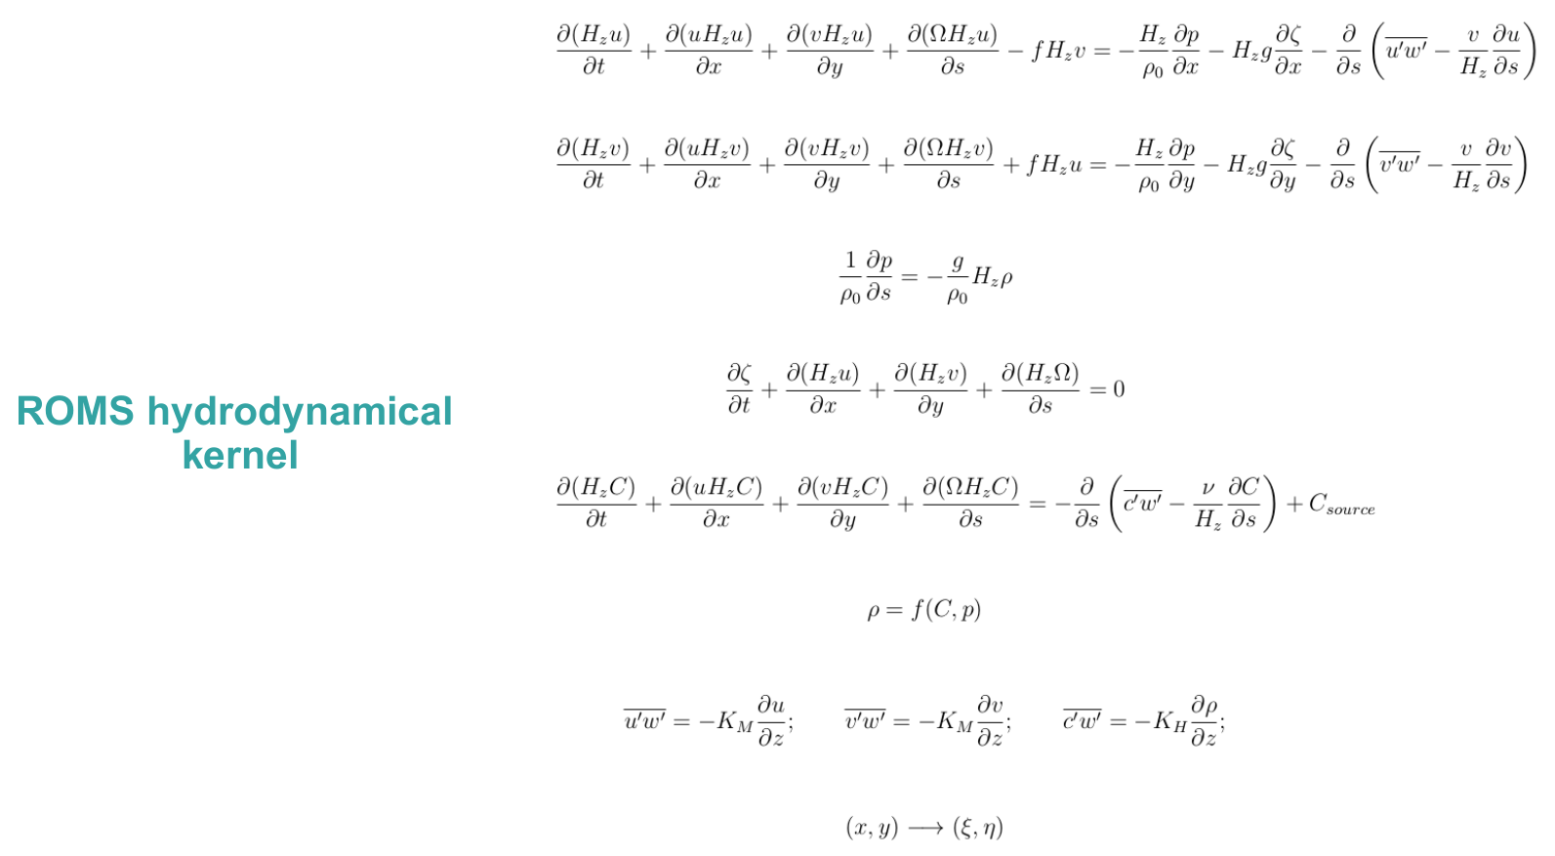
Numerical Model
Haidvogel et al. (2008)
www.metocean.co.nz

Slide 5
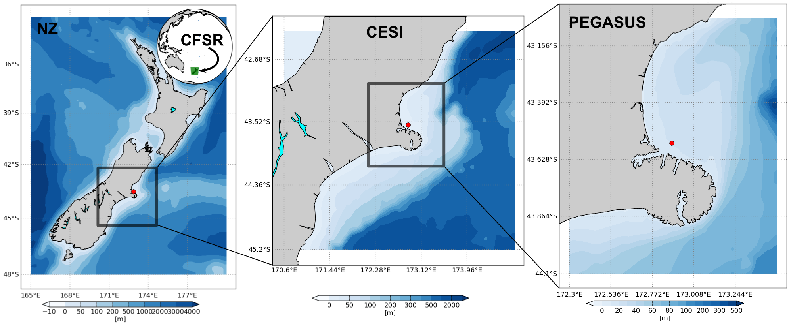
Model setup
www.metocean.co.nz

Slide 6
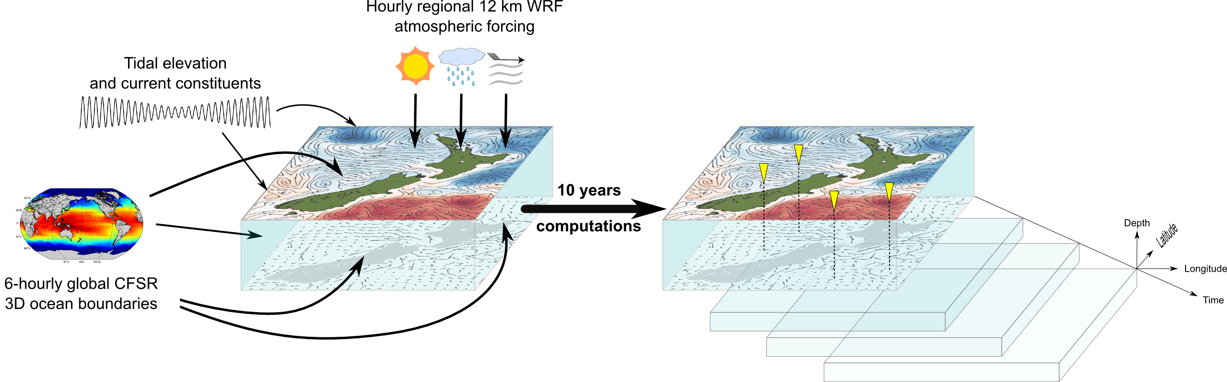
Hindcast approach
www.metocean.co.nz

Slide 7
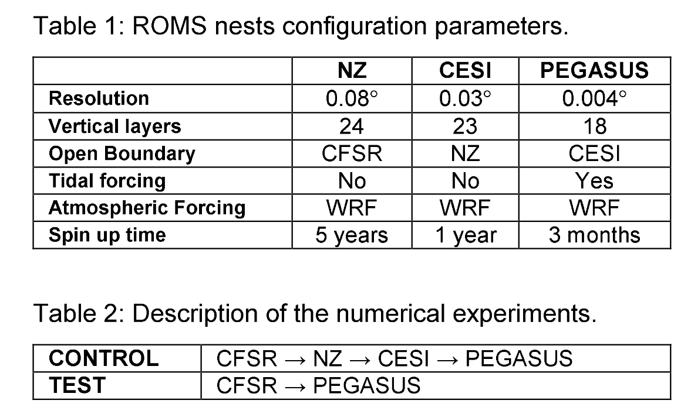
Investigation approach
www.metocean.co.nz

Slide 8
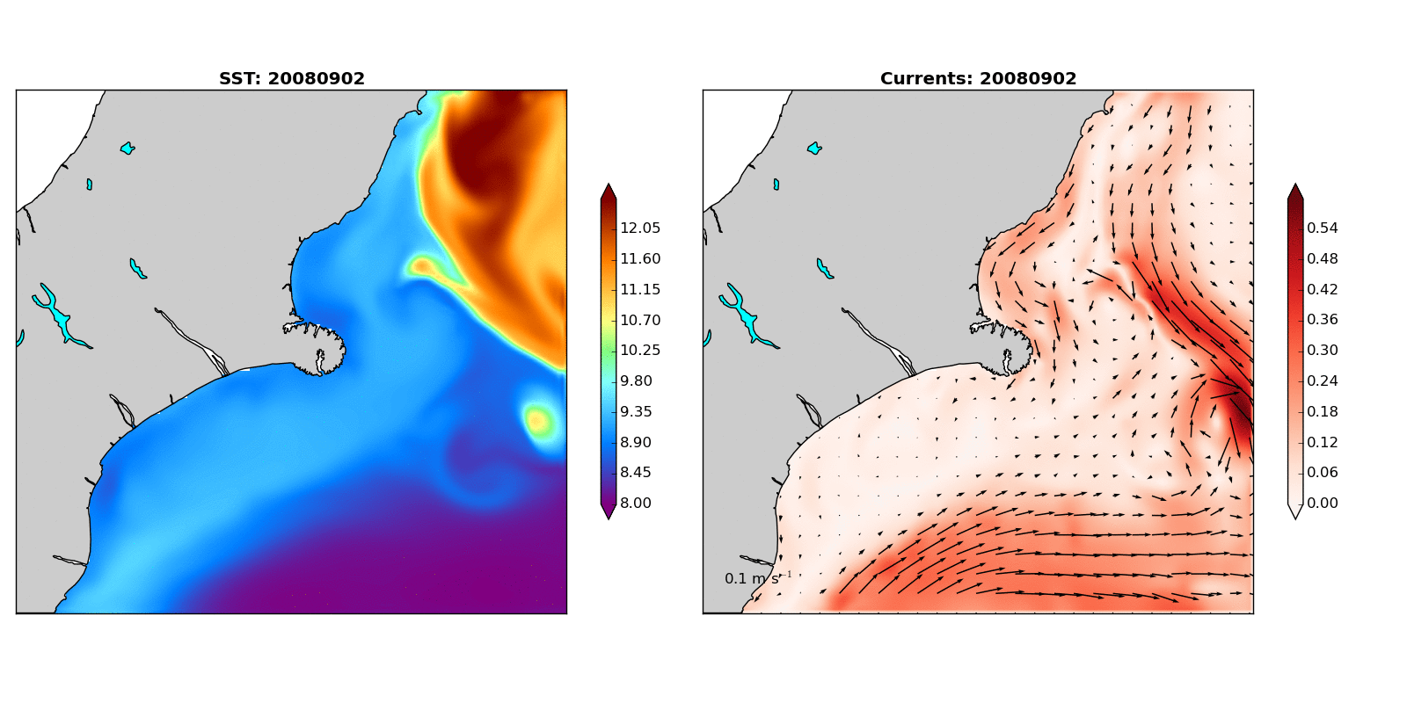
Results
www.metocean.co.nz

Slide 9
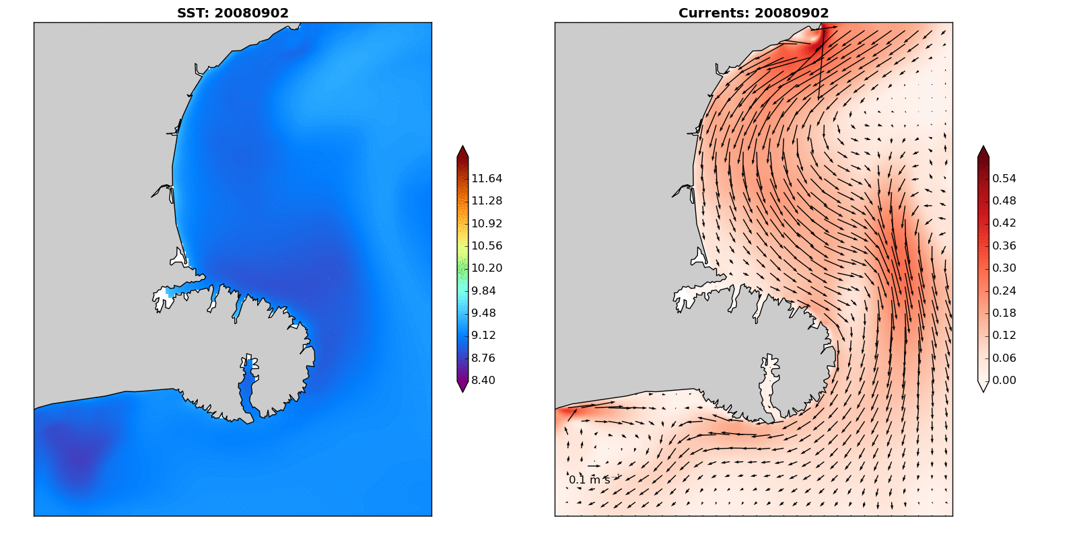
Results
www.metocean.co.nz

Slide 10
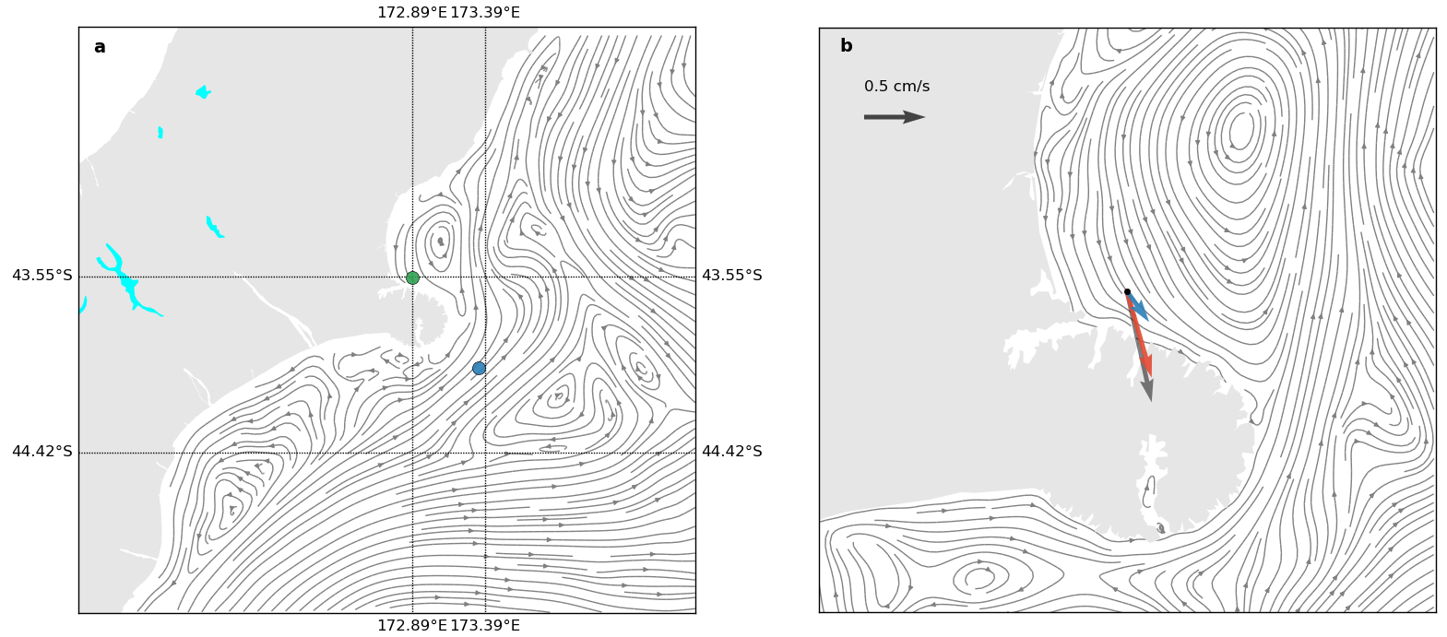
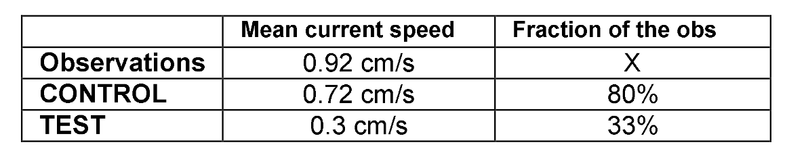
Results – average flow
www.metocean.co.nz

Slide 11
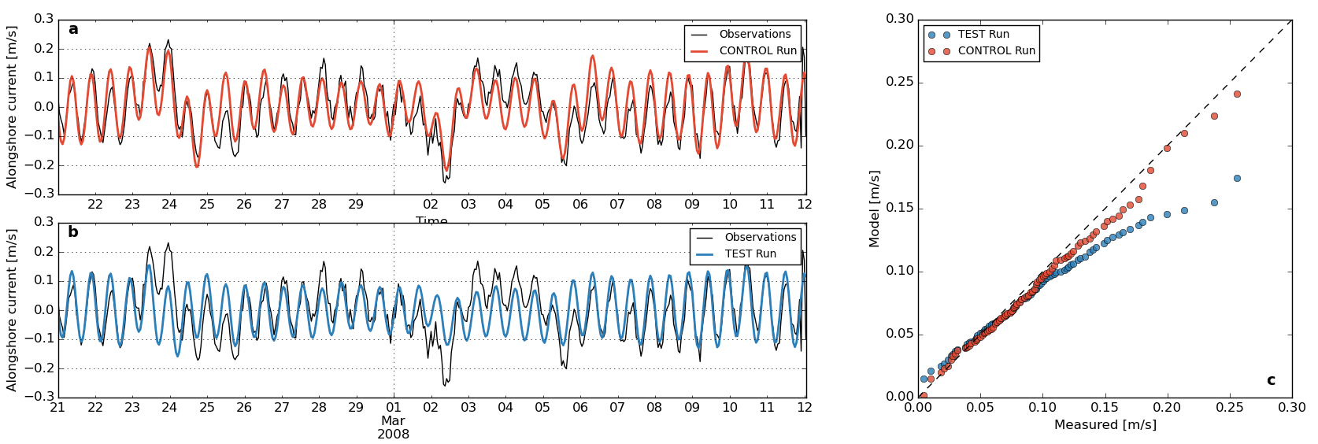
Results – model validation
www.metocean.co.nz

Slide 12
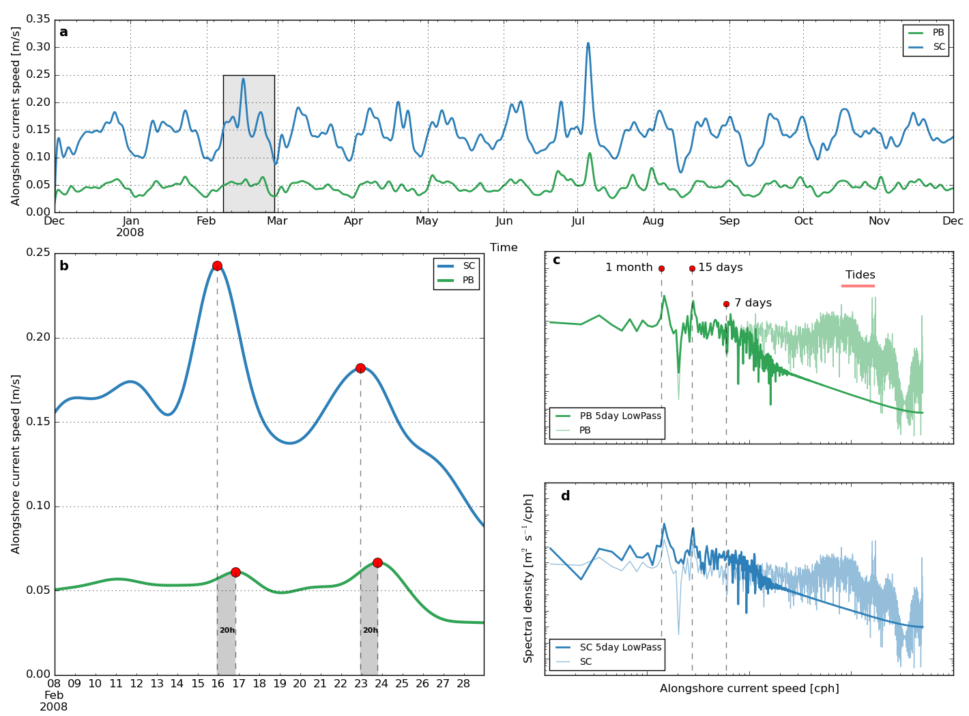
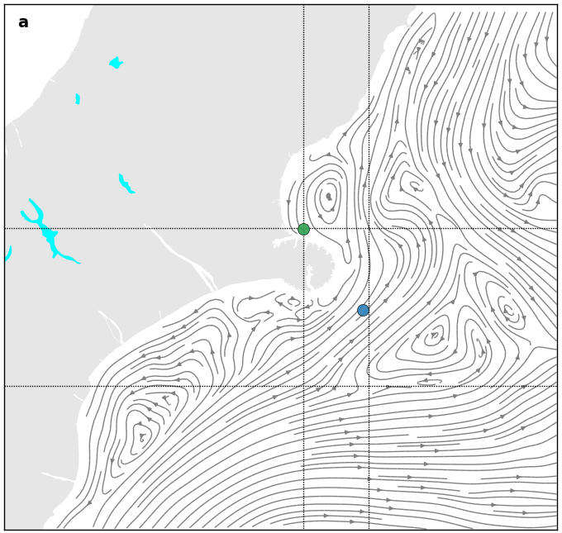
Results – along-shore flow analysis
www.metocean.co.nz

Slide 13
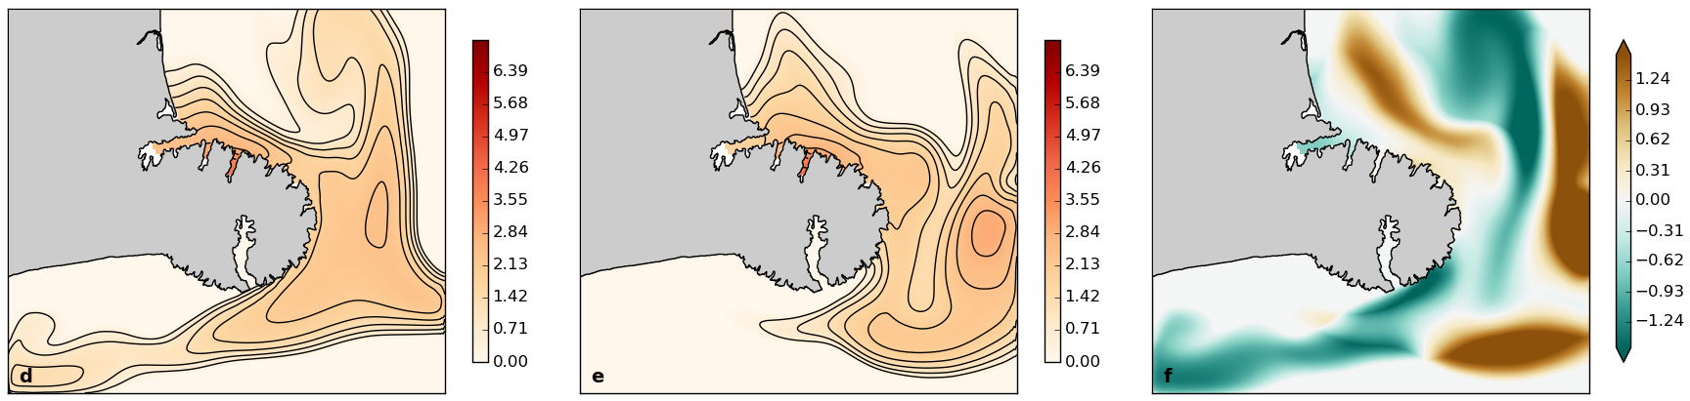
Results – potential effects on plume dispersion PUT LABELS
www.metocean.co.nz

Slide 14
Final Remarks
www.metocean.co.nz

Slide 15
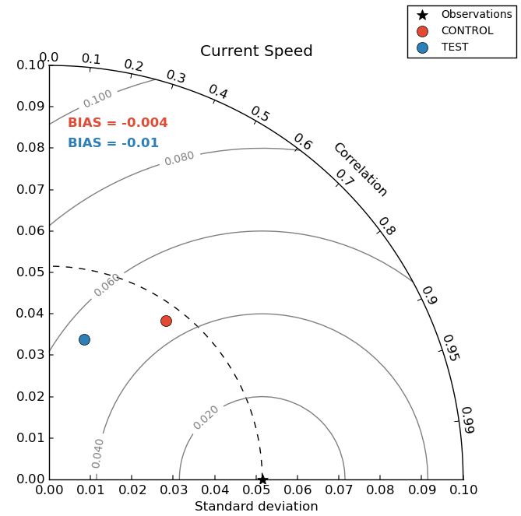
Results – model validation
www.metocean.co.nz

